Slide 1
Representation of Regional Identity

Slide 2
Regional Identity - UK
Regional Identity refers to the part of the United Kingdom someone is from. It could refer to a general area such a “north” or “south”, a country such as “English” or “Scottish” or specific towns such as “London” or “Manchester.”

Slide 3
There are several regional stereotypes widely seen on television:

Slide 4
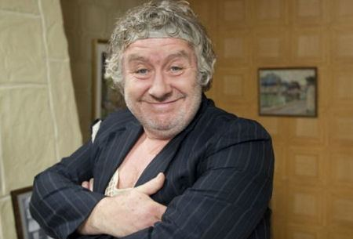
Scottish
Scottish – often shown as being money obsessed, won’t pay for anything, drinks a lot of alcohol, loves the outdoors, wears kilts, eats haggis, quite aggressive and violent

Slide 5
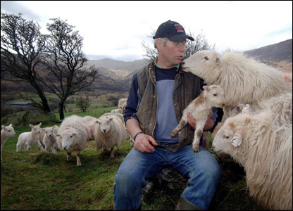
Welsh
Welsh –Often shown as living in the middle of the countryside, obsessed with sheep, singing, rugby and being Welsh

Slide 6
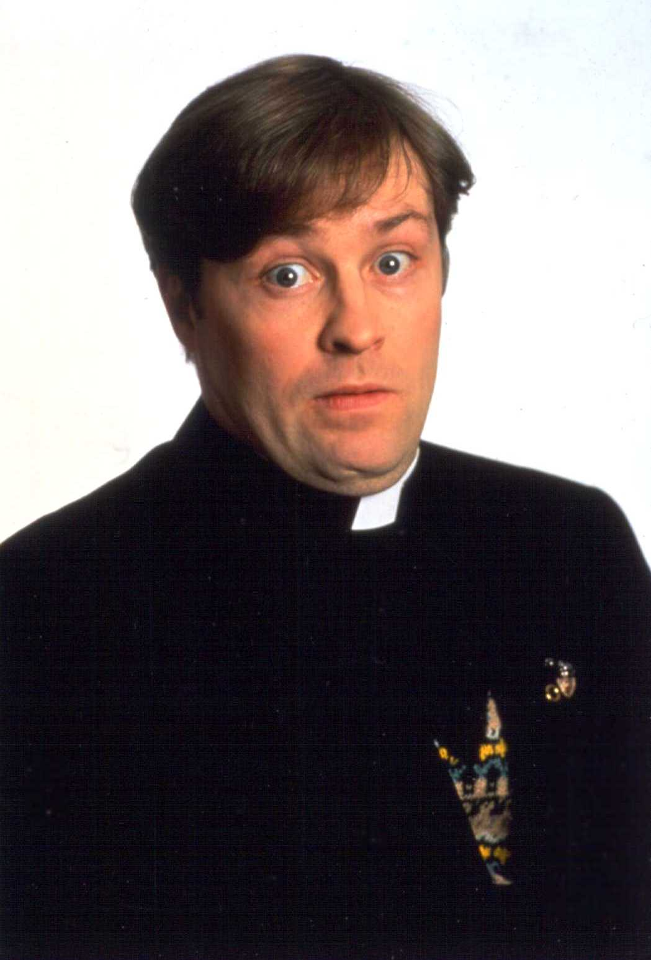
Irish
Irish – often shown as living in the countryside, working in rural areas such as farms, being very religious, being good at dancing and singing, very friendly but less intelligent

Slide 7
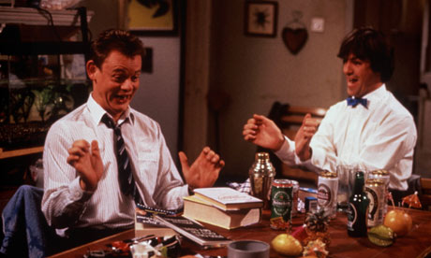
English
English – often shown as being racist, obsessed with beer and football living in London.
Sometimes the stereotype goes in the opposite direction of showing English people as very rich, posh, happy, living in castles and being very “royal.”

Slide 8
Northern England
North England – often shown as being poorer, bad weather, lower class, aggressive, less culture, less clever, doing working class jobs such as builders etc

Slide 9
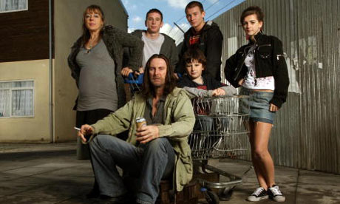
Manchester/Newcastle/Liverp
Manchester / Newcastle / Liverpool – Often shown as being “chavs”, wearing fake designer labels, or tracksuits, drinking a lot, being aggressive, uneducated, criminals

Slide 10
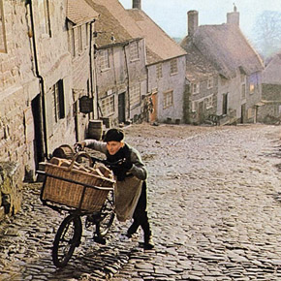
Yorkshire
Yorkshire – Often shown as living in rural countryside, with rolling hills and cobbled streets, being quite old fashioned

Slide 11
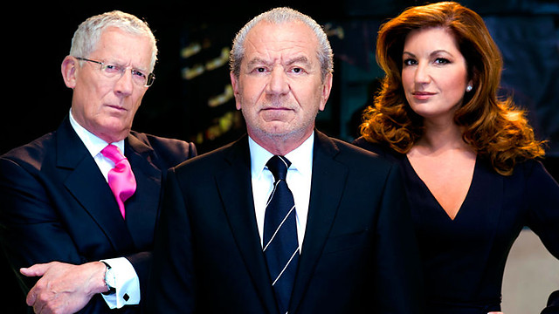
Southern England
South England – often shown as being the centre of culture, modern, classy, clever, sunny, richer, doing middle class jobs such as managers etc

Slide 12
London
London – There are 2 main stereotypes of Londoners. One is that they are often shown as being rich, posh, snobby, upper class,
The other is that they often shown as being from north, east or south London, poor, common, lower class, criminalistic, violent “Kidulthood” style

Slide 13
Essex
Essex – often shown as being glamorous but cheap, footballer’s wives, lots of partying, being quite stupid

Slide 14
South West England
Cornwall / Somerset – Often shown as being “backwards”, living in rural areas, working on farms

Slide 15
If you get “regional identity” as an issue in the exam, you should be thinking about the following things when watching the clip:

Slide 16
Can I identify where the characters are from within the country?
Are people from different areas shown as having different interests, personalities, attitudes, behaviours? If so, how?
Is their regional identity represented as being important in their life?
Are people from particular regions portrayed as being better, more powerful, than others?
Are people from particular regions portrayed as being weaker/less important than others
How do other characters in the clip treat the characters from different regions?
What is the message the clip is trying to portray about regional identity?

