Slide 1
Representation and
Textual Analysis

Slide 2
What you need to analyse in the exam
Mise-en-Scene
Sound
Editing
Camera shots, angles, movement position and composition.

Slide 3
Why is analysing Representation important?
DOMINANT ‘IDEOLOGIES’
Cultural beliefs or a way of looking at things.
Often thought of as common sense.
Assumptions that aren’t necessarily true.
The Media creates and nurtures these ideas creating ‘social myths.’

Slide 4
Textual Analysis
Literally means analysing text and in our case the text will be a 5 minute clip from a recent British television drama.
Ask yourself
What lies beneath the text. What ideologies are being created or reinforced?
How are they portraying the world and different social groups?
How is this reinforced through the techniques used? (mise en scene, camera, editing, sound.)

Slide 5
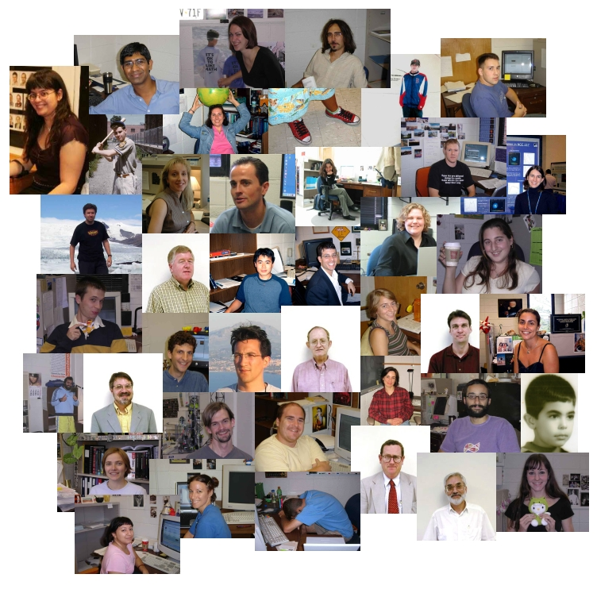
Representation of Social Groups
In the exam you will be asked to consider one of the following
Age.
Gender.
Ethnicity.
Sexuality.
Social Class and Status.
Physical Ability/Disability.
Regional Identity.
This presentation will
specifically focus upon stereotypical representations of ethnicity and sexuality.

Slide 6
Representations of Ethnicity
Ethnicity, like sex, is a set of genetically defined, biological characteristics.
However, like gender, it is also associated with a set of culturally defined characteristics.
Representations of ethnicity in the media can consist of the same sort of rigid stereotypes that constitute gender portrayal.

Slide 7
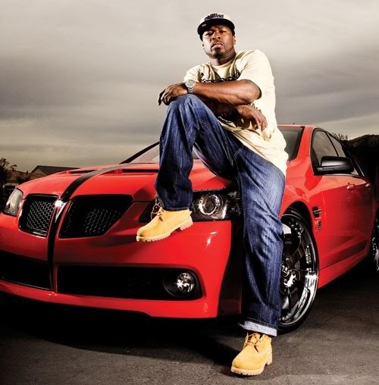
Representations of Ethnicity
Afro/Caribbean Stereotypes
Gangster.
Fun loving.
Athletic.
Sexist/Homophobic Males.
Materialistic.
Hospitable.
Impoverished.
Involved in drugs (dealing/taking.)
Criminal.
Victim.
Hero

Slide 8
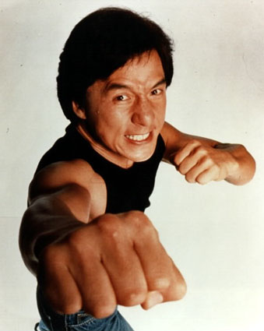
Representations of Ethnicity
East Asian Stereotypes
Intelligent.
Hard working.
Determined.
Sinister.
Martial arts.
Obsessed with electronics.
Quirky.
Physically weak.
Ruthless.
Lacking emotion.
Submissive women.

Slide 9
Representations of Ethnicity
Latin American Stereotypes
Lazy.
Uneducated.
Easy going.
Impoverished.
Hedonistic.
Ridiculed.
Illegal aliens.
Involved in drugs (dealing/taking.)
‘Exotic’ sex symbols (Antonio Banderez, Jennifer Lopez, Salma Hayek, Shakira).

Slide 10
Representations of Ethnicity
Middle Eastern/ South Asian/ Arabic Stereotypes
Terrorists.
Devout.
Glamorous.
Educated.
Oppressed females.
Religious fanatics.
Sophisticated and Cultured.
Formidable.
Serious.
Cruel/brutal.
Victims.
Villains.

Slide 11
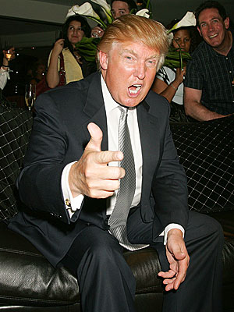
Representations of Ethnicity
White British/American/European Stereotypes
Affluent.
Educated.
Socially awkward.
Restrained.
Moral.
Rational.
Arrogant.
Repressed.
Neurotic.
Racist.

Slide 12
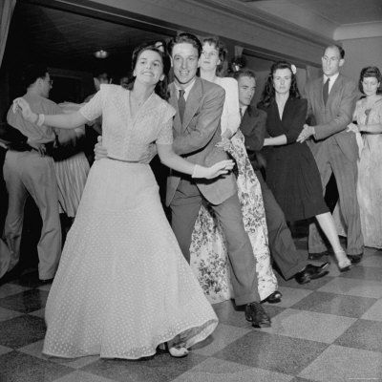
Representations of Sexuality
Important points to consider
Gender closely ties in with sexuality.
Sexuality is often expressed through physical means; clothes, props, setting, acting.
Understanding how a particular character’s gender is constructed will help you analyse how their sexuality is being represented.
How is sexuality constructed in terms of:
Heterosexuality ?
Homosexuality ?

Slide 13
Representations of Sexuality
Heterosexual Stereotypes (Female)
Loving.
Loyal.
Vulnerable.
Monogamous.
Sexually available.
Seductive.
Frigid.
Virginal/naive.
Deviant (‘gold digger’, ‘pregnant teen’, ‘Cougar’‘ femme fatale’.)

Slide 14
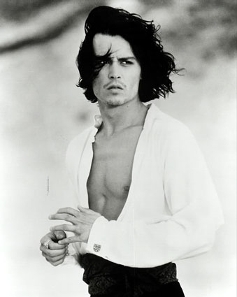
Representations of Sexuality
Heterosexual Stereotypes (Male)
Promiscuous.
Physically and mentally strong.
‘Ladies Man’, ‘Heart Throb.’
Aggressive.
Sensitive ‘New Man’.
Lazy.
Competitive.
Irresponsible.
Misogynist.
Awkward.
Selfish.

Slide 15
Representation of Sexuality
Homosexual Stereotypes (Female.)
Monogamous.
Feisty.
Loyal.
‘In the closet.’
Humourless.
Politically radical.
Confrontational.
Plain/unattractive.
Sincere.
Feminist.
Erotic.

Slide 16
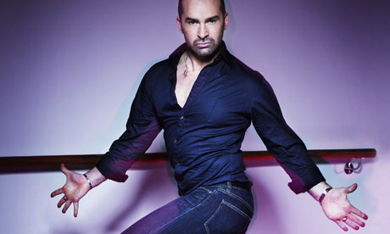
Representations of Sexuality
Homosexual Stereotypes (Male)
Promiscuous.
Sensitive.
Caring.
Funny.
Supportive.
‘In the closet.’
Flamboyant.
Superficial.
Overbearing.
Loud.
‘Bitchy’.

