Slide 1
Representation of Disability
L.O.
To understand how disabilities are represented in the media

Slide 2
List…
Mindmap or list all the different types of disabilities you can think of.

Slide 3
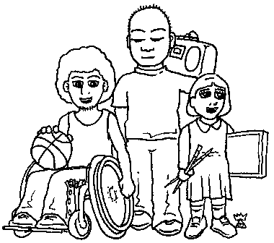
Definition of disability
a physical or mental condition that limits a person's movements, senses, or activities.
e.g.: Physically and mentally disabled, Hearing impaired, Visually impaired, Short term and long term disability, cognitive disability…

Slide 4
Can you think of any recent programmes or films you have watched that contain any disabled characters? How were they represented?

Slide 5
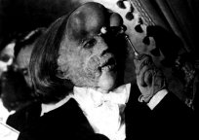
Usual Stereotypes:
Pitiable and pathetic; sweet and innocent; a miracle cure
The Elephant Man

Slide 6
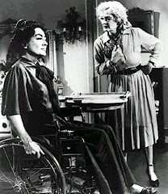
Victim or an object of violence
Whatever happened to Baby Jane?

Slide 7
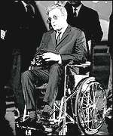
Sinister or evil
Dr Strangelove

Slide 8
Atmosphere or curio
e.g: 'freak shows', and in comics, horror movies and science fiction

Slide 9
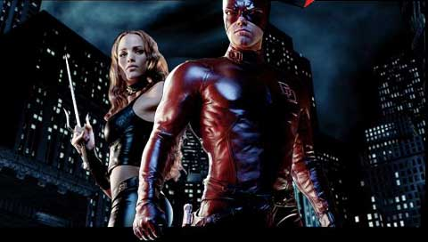
'Super-crip'/ triumph over tragedy/noble warrior
Daredevil

Slide 10
Laughable or
the butt of jokes

Slide 11
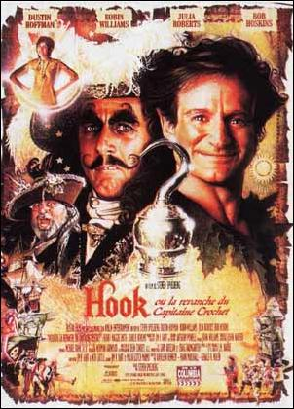
Vengeful:
Having a chip on their shoulder/ aggressive avenger

Slide 12
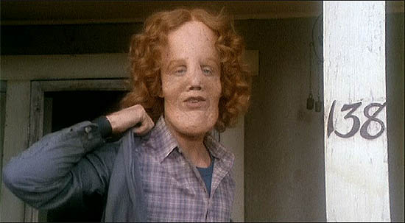
A burden/ outcast
Mask

Slide 13
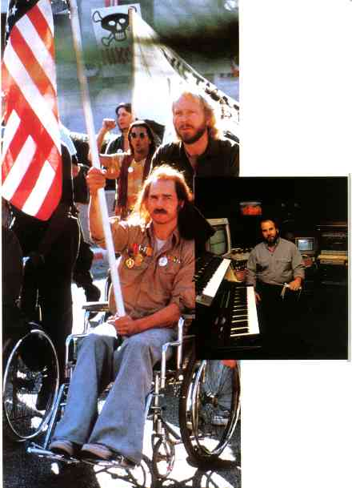
Non-sexual or incapable of a worthwhile relationship
Born on the Fourth of July

Slide 14
Under- and mis-representation of disability
The absence of disabled people from everyday situations, and not being shown as integral and productive members of society. When they are shown, the focus is on their impairments.
Often shown as incapable of fully participating in everyday life

Slide 15
In pairs: How would you represent them using the micro elements? Camera, Sound, Mise en Scene, Editing
Physically disabled:
Mentally disabled:

Slide 16
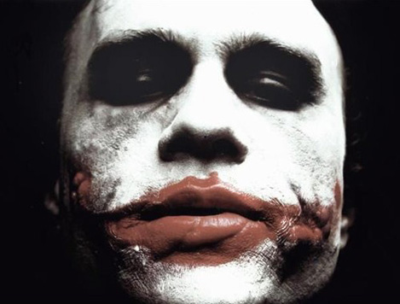
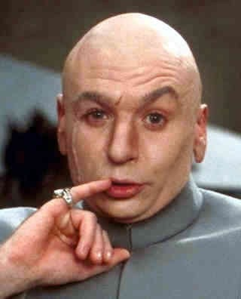
Are these typical representations? Why?
What stereotype do these characters reinforce?

Slide 17
Have a go
https://www.youtube.com/watch?t=48&v=80K5P1qqQOI
https://www.youtube.com/watch?t=100&v=_Gl8jVX9WWM
http://cbscmediatvdrama.blogspot.co.uk/2011/09/representation-of-disability.html

