Slide 1
Print adverts

Slide 4
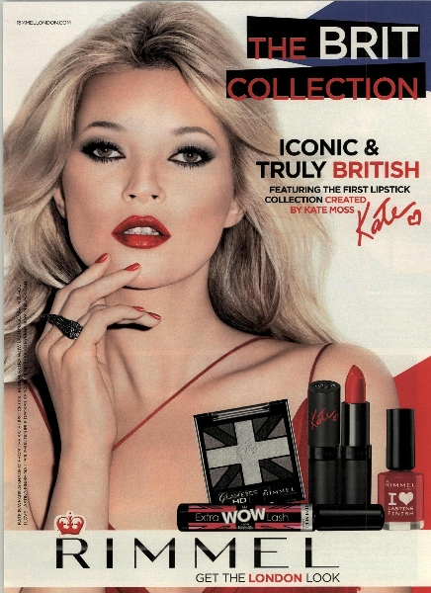

Slide 5
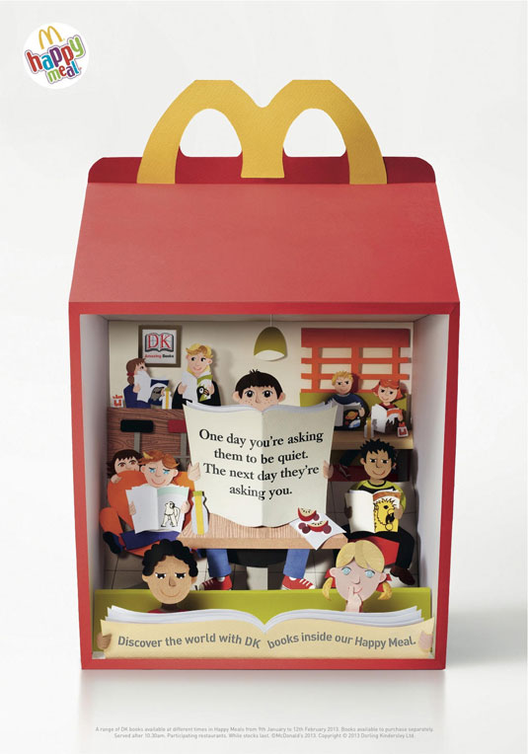

Slide 7
