Slide 1
Photoshop Tools

Slide 2
Add a layer mask add an adjustment
Add a new layer delete a layer

Slide 3
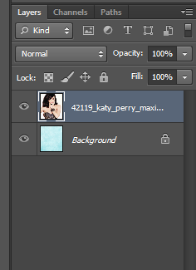
Layers – the one on top is at the front
Opacity – how transparent the layer is
Normal – blending options – how the layer blends with the others beneath it
Eye – click to hide the layer

Slide 4
Move and selection tools
Click the arrow in the right hand corner for different options
Hover the mouse to find out what the tool is

Slide 5
Spot healing
Brush
Clone
Eraser
Gradient
Blur
Dodge/burn/sponge

Slide 6
Text tool
Shape tool
Zoom
Colour selection
Toggle between colours

