Slide 1
Representation of gender in TV drama
Discuss the way gender is represented in the following still images. Refer to the mise en scene and use of camera in your answer.

Slide 2
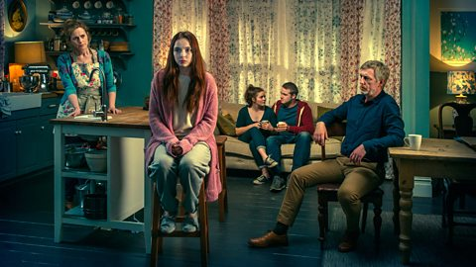

Slide 3
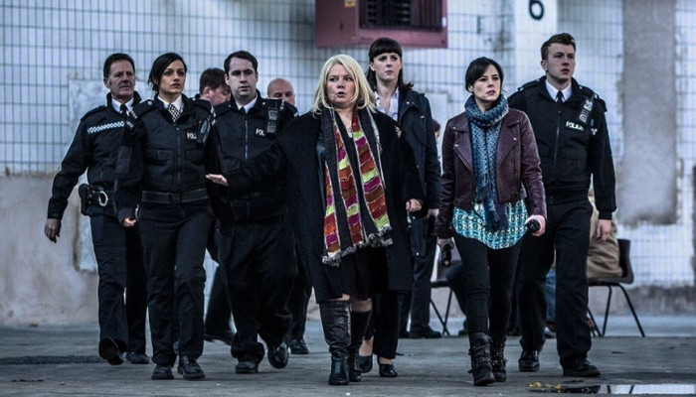

Slide 4
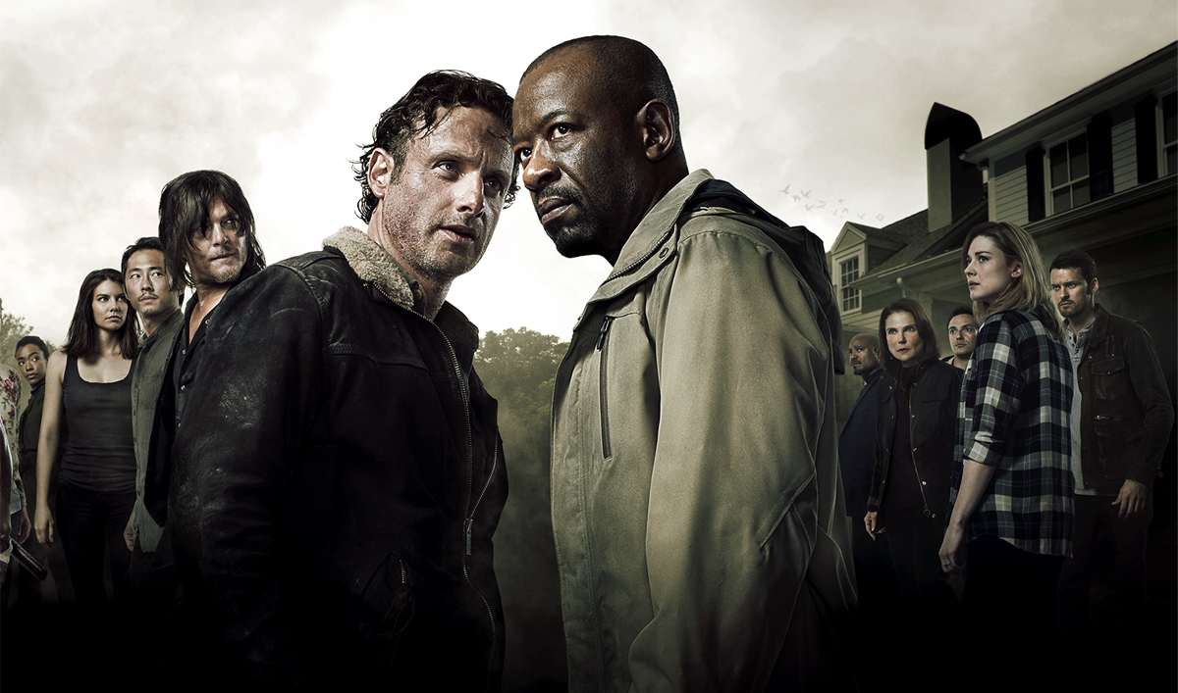

Slide 5
