Slide 1
Iphone and Comment Is Free
‘We Media’ and Democracy

Slide 2
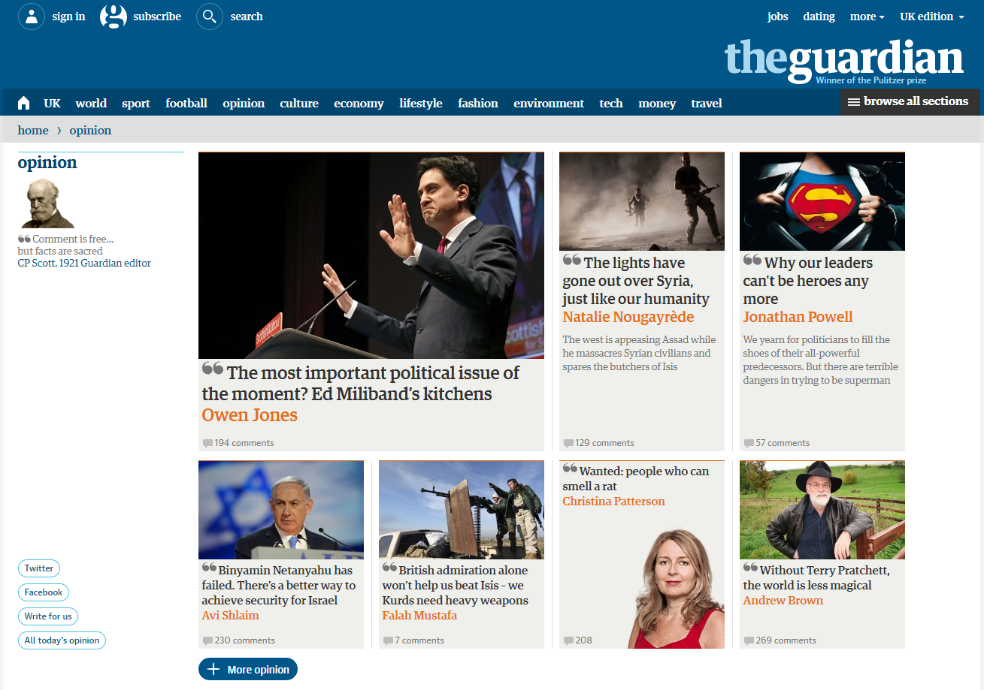
What is ‘Comment Is Free’?
‘Comment is Free’ is a site within theguardian.com which was set up in 2006, is a site that allows anybody to post comments surrounding the world’s news and current affairs.
‘Comment is Free’ is used for collating comments and opinions and sharing political views.

Slide 3
History & Development of Comment Is Free
Comment Is Free was launched after journalists from the Telegraph and Guardian newspaper came together to change the traditional ways of sharing news. It was also aided by the Guardian Media Group (GMG) who own both newspaper broadsheets.
March 14th 2006
Present day:
CiF is still running in the present day and continues to be popular includes sections such as ‘The Guardian View’, ‘Spotlight’, ‘Cartoons’, Columnists’, ‘Letters’ and ‘You May Have Missed’.
Since starting they have creating an online community mainly with people who share the same views.
They use the subsite, ‘The CiF Belief’ to voice their opinions and start discussions. It is updated every week to collect views and display an overview of religious and ethical subjects.

Slide 4
Facts and Statistics
There are over 600 writers that create articles for people to comment on. These articles are the beginning of each discussion and each article opens a new discussion.
Over 100,000 members of the public actively take part on the site, sharing their views and opinions.

Slide 5
Case Studies
The site is continually updated on a daily basis with current news surrounding a variety of topics.
Very recent and up to date stories are posted, making the website both relevant and current.
This creates a platform for new and upcoming news stories for both the public and existing journalists to explore.
People want to be able to access real-time news and by involving citizens from all backgrounds makes this possible.

Slide 6
The iPhone
The iPhone is a smartphone that is made by Apple that combines an iPod, a tablet PC, a digital camera and a phone. The iPhone includes internet browsing and networking.
The iPhone has many uses, which includes thousands of apps that are free or available to buy on all Apple products including the iPhone.

Slide 7
History & Development of the iPhone
e
Apple introduced the second generation iPhone. This iPhone operates on third-generation (3G) cellular networks and has a GPS receiver. It also lets you view map and satellite data from Google Maps, including overlays of nearby businesses.
Apple releases the iPhone 4 The iPhone 4 has two cameras, one on the front and one on the back. The iPhone 4 has a retina display with a better resolution than before. Steve Jobs also announced a new name for the iPhone operating system: iOS, a modified version of the Macintosh OS X operating system used on Apple desktop and laptop computers.
Iphone 4S is brought to China and 21 other countries
The iPhone 5 was the released at the end of 2012 which was 18% thinner and 20% lighter.
2008
2010
2007
2012
2012
2014
2009
2011
2013
Steve Jobs introduced the Apple iPhone during his keynote address at the Macworld Conference and Expo. Designed and marketed by Apple inc.
6 and 6 plus were released which included NFC circuitry allowing you to buy things using Apple pay technology
Apple launched the iPhone 3GS. The 3GS iPhone models have more storage capacity than the previous Iphones. They also have a better camera that you can use to take still shots and video at 30 frames per second. Another added feature is a compass. Also in 2009 came iPhone OS 3.0, which offered many improvements, like the ability to copy and paste.
In October 2011, Apple launched the iPhone 4S, with the faster A5 processor and an improved camera that shoots 8 megapixel images and 1080p high-definition video. The 4S was also the first phone that could take advantage of a major addition to Apple's iOS, which debuted with iOS 5, which included Siri which is a voice activated assistant on your phone.
The iPhone 5s and 5c were then released, the iPhone 5c was made from plastic and came in a variety of colours, which was a lower price option. The 5s and added a security enhancement in the form of a fingerprint identity sensor.

Slide 8
What is it used for
The Iphone can be used for a variety of things mainly linking to the internet and apps that also use the internet.
You can use the Iphone to make and receive calls, watch movies, listen to music, browse the Web, and send and receive e-mail and text messages. You can also take pictures and video with a built-in camera, import photos from your computer and organize them all using the iPhone's software. It is more like a computer than a phone.
Iphones can be used for apps such as twitter, facebook and instagram which are the biggest social networking sites where apps are available on Iphone making them easy to access.
Apps to analyze data for better decision making and more powerful transactions.
Apps that allow businesses to do what they have never done before.
There are apps for everything you need on the iPhone.

Slide 9
Facts and Statistics
The one millionth Iphone was sold just 74 days after its launch.
In 2008 1 million Iphone 3G’s were sold on the first weekend.
In 2009 there was 1 billion app store downloads and over 100,000 apps available.
In 2011 NASA’s astronauts use the iPhone to help track their scientific results.
There are now 1.3 million apps available in the app store.
There were 2 million pre orders of the iPhone 5 in the first 24 hours, which was an increase from the iPhone 4 and 4S.
83% of iPhone 5 buyers upgraded from the previous iPhone.
9 million Iphone 5s and 5c’s were sold in just 3 days.
iPhone 6 and 6 plus sold 10 million in it’s first weekend.

Slide 10
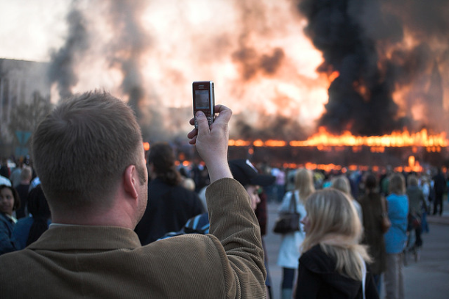
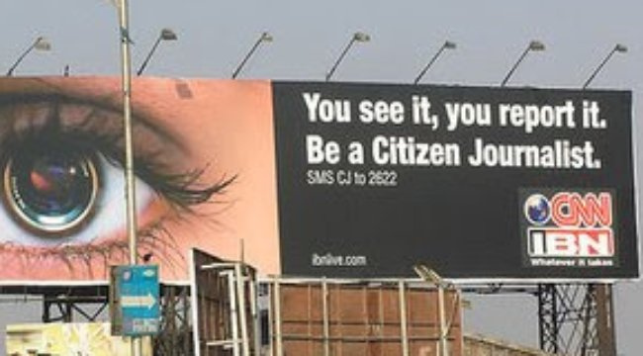
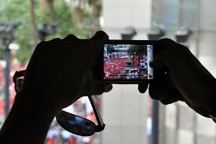
Case Studies
Things like photography, the music industry and business industries have changed since the arrival.
One of the largest impacts it has created is that on the news and journalism world.
News consumption used to consist of printed documents and live channels. However the iPhone has changed this and has meant that sources of news, like Twitter, have become more accessible and popular.
The iPhone has made these apps more user friendly and has also changed the creation of the news that we see today.
The tools to create, publish and capture text, photos and video wherever you are means publishing and sharing news is quicker and freer than ever.
Overall, out of all android and smart phones, the iPhone was the first smartphone to make all of these things possible.

