Slide 1
Conventions of
Magazine Front Covers

Slide 2
Magazines
What I will learn:
  The key conventions of a magazine front cover
  The conventions of straplines
How I will show I’ve learnt it
  Magazine conventions task
  Find and label my own front cover

Slide 3
Key Word
A word that is special to this subject that you need to remember
Look out for the key!

Slide 4
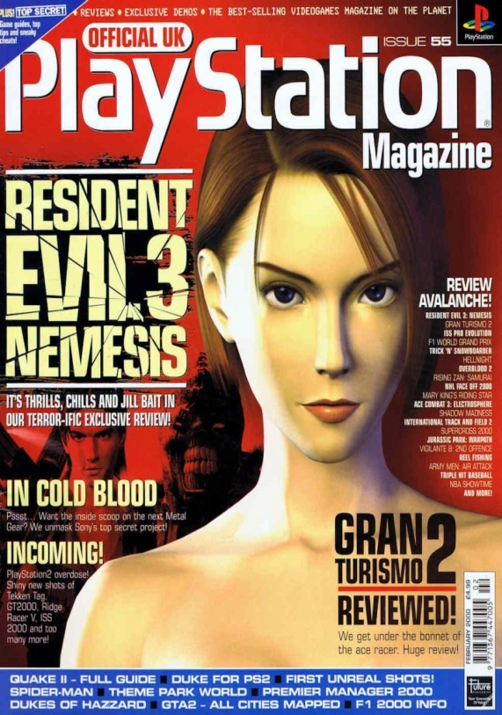
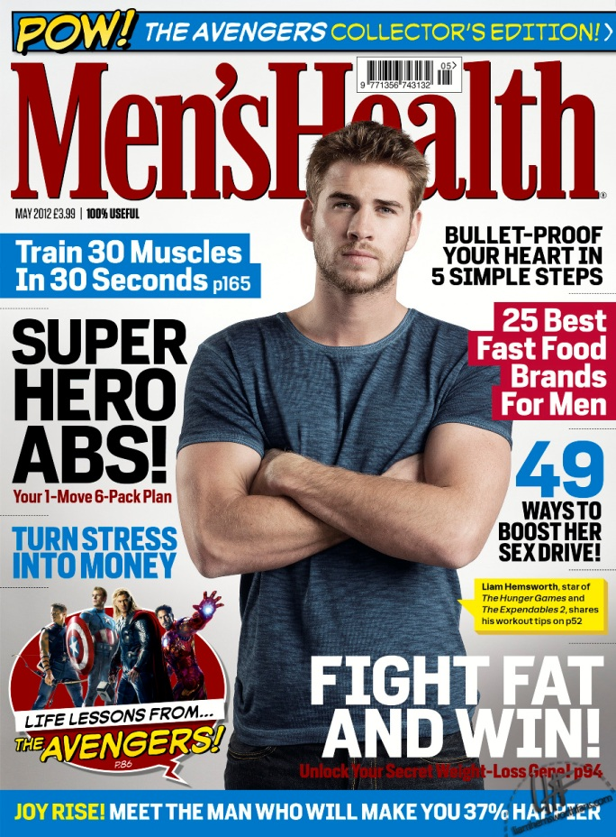
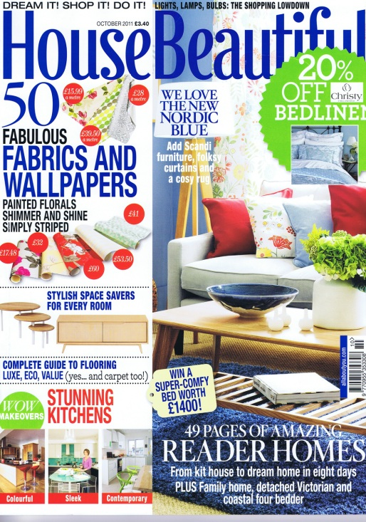
Discussion:
Magazine Front Covers
Why is the front cover of a magazine so important?
Notes:
It’s the first part of the magazine you see
It attracts you to buy the magazine
It tells you what’s inside the magazine
It tells you what the magazine is called
It tells you who the audience of the magazine is

Slide 5
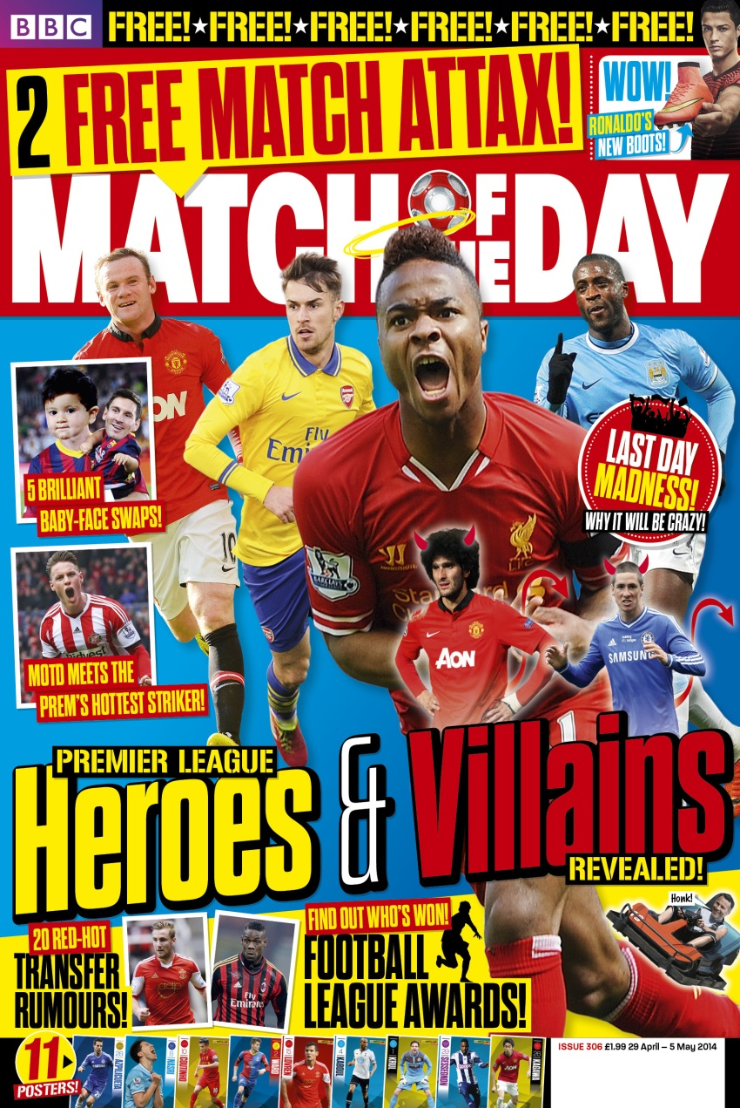
Front Cover Conventions
Selling Line
Skyline
Masthead
Puff
Coverline or strapline
Cover image
Kicker
Direct Address
Pull quote
Dateline/Issue
Notes:
The key conventions of a front cover

Slide 6
Conventions
Coverline/strapline
  A catchy phrase that tells you what an article in the magazine is about
Dateline
  The month the magazine is issued
Kicker
  The largest coverline – usually placed near the bottom of the page
Masthead
  The title of the magazine – it is placed at the top of the magazine to stand out
Puff
  A coloured block (like a sticker) on the front cover with information that help sell the magazine
Pull quote
  A quote taken directly from an article inside
Selling Line
  A phrase that makes the magazine sound attractive
Skyline
  A coloured block at the top of the magazine. It often contains the selling line
Direct Address
  The audience is directly spoken to using the first person ‘you’ and imperatives
Left Third
  The main coverlines are shown on the left hand side of the magazine so they can be seen on a horizontal shelf
Website
  The magazine’s website address

Slide 7
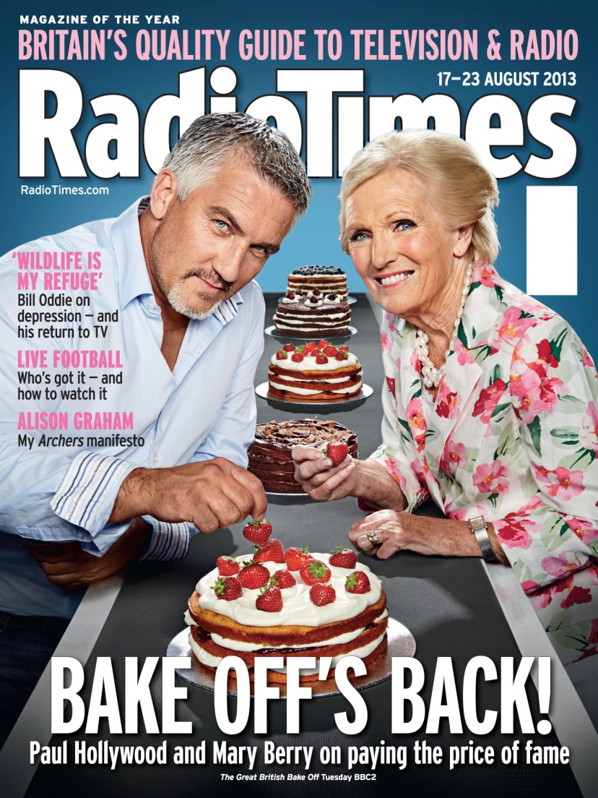
Conventions of straplines
Exaggeration
Quotations
Direct address
Exclamations
Alliteration

Slide 8
Design and layout
Maximum of three font colours
Colours complement each other
One or two font types
Simple, easy to read font
Mixture of upper and lower case
More straplines on the left
Use of different sized fonts for emphasis
Text frames the image

Slide 9
Analyse the Conventions of a Magazine
Find your own magazine front cover
Label the conventions
Label examples of strapline techniques
  Personal pronouns/direct address
  Exclamations
  Alliteration
  Use of 3
  Pull quotes
  Instructions/imperatives
  Any other

