Slide 1
Lego Advertisement 1981
Compare the representation of gender in children’s toy advertisements from different times.
Name:

Slide 2
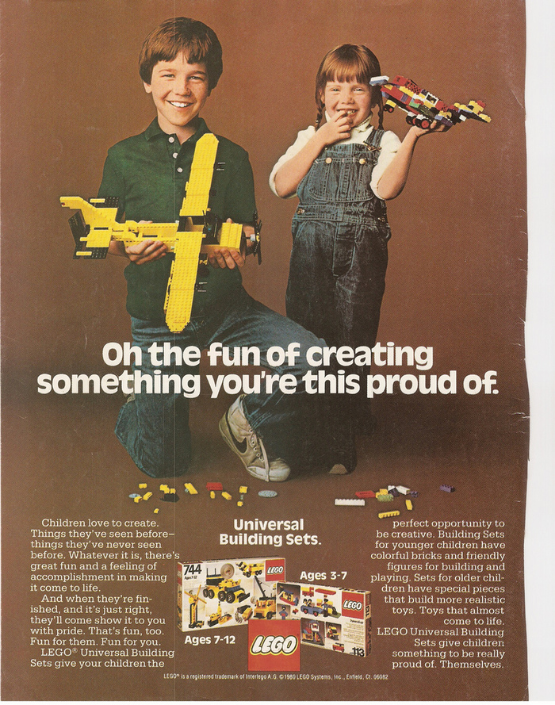
Image/Layout
Notes:
What is being shown in this image? Describe what you see and what they are doing.
Comment on the
choice of camera shot
The composition of the image – how the actors have been positioned, what elements are shown to be more important than others

Slide 3
Mise en Scene
Costume
Notes:
Describe the connotation and denotation of the costumes referring to way gender is shown. Do the costumes conform to or subvert gender stereotypes?

Slide 4
Mise en Scene
Acting/Action
Notes:
Describe what the actors are doing, where they are looking and the relationship between them. Comment on the way gender is shown.

Slide 5
Mise en Scene
Props
Notes:
Describe the connotation and denotation of the props referring to way they either conform to or subvert gender stereotypes

Slide 6
Mise en Scene
Setting
Notes:
Describe the connotation and denotation of the setting – comment on how the choice of background/colour reflect gender.

Slide 7
Language
Notes:
Describe the connotation and denotation of the setting – comment on how the choice of background/colour reflect gender.

Slide 8
Language
Notes:
How does the language support or go against gender stereotypes?

