Slide 1
Jess Glynne
Music Promo Case Study

Slide 2
Background
Jess Glynne is an English singer and songwriter, signed to Atlantic Records UK.
She rose to prominence as a featured artist on Clean Bandit's single "Rather Be" and Route 94's "My Love", both of which reached number one on the UK Singles Chart in 2014.
Her debut solo single, "Right Here", reached the top ten and her second, "Hold My Hand", was number one for three weeks.
Glynne's debut album, I Cry When I Laugh, was released in August 2015.
In the UK, she became the second British female solo artist after Cheryl Tweedy to have five number-one singles.^{[6]}

Slide 3
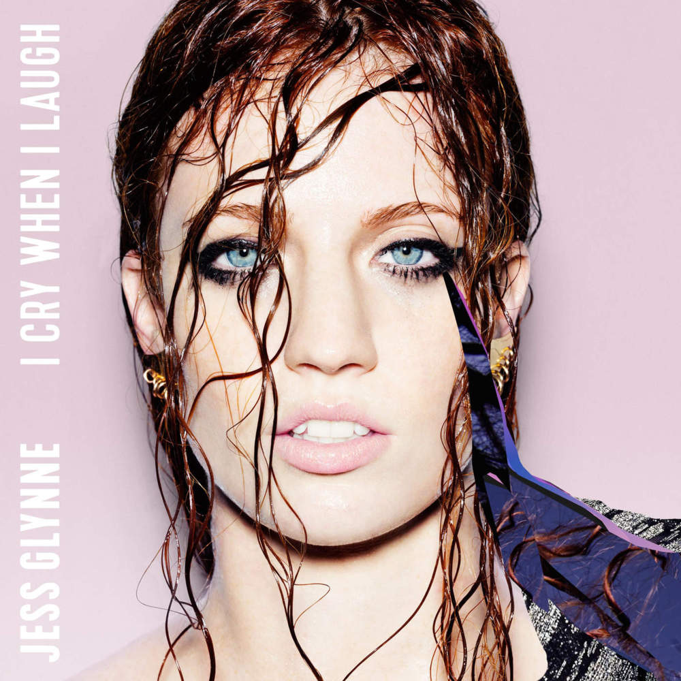
Album Cover
In pairs produce a detailed analysis of the album cover.
You must include the following:
Camera shot
Mise en scene
Layout
Font style
Use of language
Who is the target audience and why?
Can you tell the genre of music from this image?
What kind of image is created for the artist with this album cover? What is her star image?
Your analysis must consider the meaning/effect of all of the above elements. (Use connotation/denotation)

Slide 4
Don’t Be So Hard On Yourself
Look at the lyrics to Don’t Be So Hard On Yourself
What is the message of the song?
Do these lyrics tell us anything about the artist and her audience?
What sort of language is used?

Slide 5
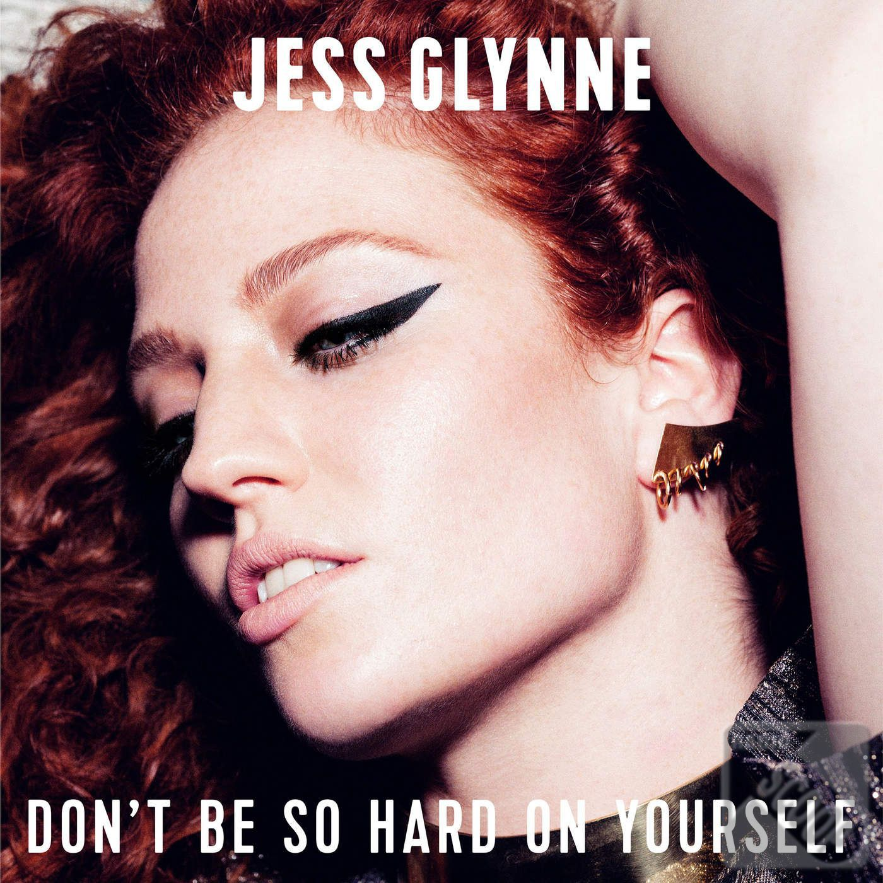
Don't Be So Hard On Yourself
In pairs produce a detailed analysis of the single cover.
You must include the following:
Camera shot
Mise en scene
Layout
Font style
Use of language
Who is the target audience and why?
Can you tell the genre of music from this image?
What kind of image is created for the artist with this single cover? What is her star image?
Your analysis must consider the meaning/effect of all of the above elements. (Use connotation/denotation)

Slide 6
Music promo
https://youtu.be/THeLVhU53ow
What is the message of the video? How do the images link to the lyrics of the song? Do the images change the message in any way? How?
How are camera, mise en scene and editing used to create meaning?
Who is the target audience?
How does the music video link to the stars image?

