Slide 1
Democracy in the decade of Google & BBC Iplayer
Sandeep and Shivani

Slide 2
Google
Google was registered as a domain in 1997 and founded on September 4th 1998 by stanford university students Larry Page and Sergey Brin. By the end of 1998 it was known as one of the Top 100 search engines to use as it had more than 60 million pages and then in late 1999 they had patented it as ‘Google Inc’.
In 2004 it had handled up to 84.7% of all searches on the world wide web through its websites and partnerships with companies like Yahoo. By mid 2004 the stock market price quadrupled. By 2005 google was valued at $52 billion making it one of the worlds most biggest media companies by stock market. Whilst this was happening Google signed a partnership with NASA which involved building a 1,000,000 square foot building.
When google increased in size it created a lot of rivalry with Microsoft. When Microsoft made Internet Explorer, Google made its own operating system Linux which is now called Google Chrome OS. They also launched Gmail in 2004.
In 2006 Google bought Youtube which increased the growth of them both massively and now to this current date they have 70 offices in more than 40 countries.
In 2012 they launched Google Drive and has 240 million monthly active users to this current date.

Slide 3
Google Users
The majority of people WorldWide who need to search something will do it by the google search engine as they believe it’s the most fastest and reliable search Engine followed my Youtube which is the second largest search engine.
Has 40,000 searches made per second worldwide
Equivalent to 3.5 billion searches per day worldwide.
Equivalent to 1.2 trillion searches per year world wide.
1,100,000,000 visitors per month.

Slide 4
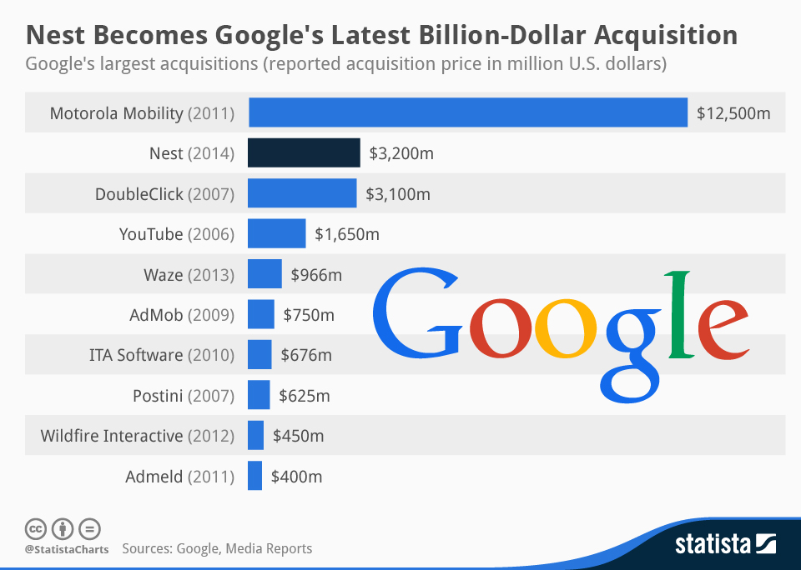

Slide 5
Significant Stories
Google Glass went public in 2014 and costs around $1500. ( touchpad, camera and record 720p HD, display is an LED illuminated display.
EU - avoiding EU fines by removing pages that has infringement on their privacy.
Robot hype - host robots through the use of artificial intelligence.
Turned in a user who was allegedly in possession of child pornography - Privacy concerns.
Google driverless cars

Slide 6
BBC Iplayer- History and development
Iplayer is a site for people to catch up on TV shows or radio shows which they may have missed. The site also allows people to download programmes.
Was released in December 2007
It is an internet streaming catchup television and radio service for people in the United Kingdom
It available on many many devices like through mobile phones running from Android or IOS, smart TV’s and computers.
It allowed people to catch up on the last 7 days of BBC TV and radio.
In April 2014, BBC iPlayer was once again relaunched with a new look and a different user interface. From October 2014, the BBC extended the programme availability for programmes on iPlayer from 7 days to 30 days.

Slide 7
BBC Iplayer- who uses it and how many users?
The original Iplayer service was launched in October 2005, undergoing a five-month trial by five thousand broadband users until 28 February 2006
In 2013 iPlayer was attracting 13.4m views to the site.
In January 2014 the requests for programmes on Iplayer has grown vastly through:
39m watching on TV
71 million on Computers
44 million on Mobile phones
66 million on tablets.

Slide 8
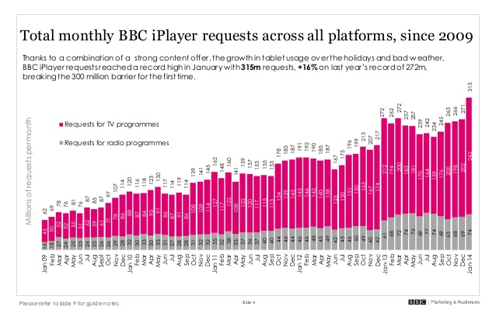

Slide 9
BBC Iplayer- who uses it and how many users?
This shows that by Jan 2014 the number of people going on the BBC Iplayer website rose to 315 million.
January 2014 was the biggest month ever for BBC iPlayer with over 315 million TV and Radio requests, breaking the 300 million barrier for the first time.
• January saw an average of 10.2m daily requests, the highest ever seen.
• The new series of Sherlock was particularly popular on BBC iPlayer in the New Year

Slide 10
BBC Iplayer- Significant stories/events linked to it...
Jan 2014 - The daily mail wrote a report stating that BBC Iplayer should ‘make viewers pay a licence fee.
This article highlights that the BBC called for reforms to deal with 500,000 homes that only watch programmes online.
Although households are technically required to buy a £145.50 licence if they watch live broadcasts on tablets or computers, it is thought many avoid detection because the BBC is unable to monitor who is watching on the internet.
A TV Licensing spokesperson said: ‘Our enforcement approach enables us to catch and prosecute people watching live TV online. Well under 2 per cent of households watch only catch up TV so don’t need a licence.

