Slide 1
Mise En Scene
Use CLAMPS to analyse how the following stills fit the action adventure genre
Consider how the mise en scene helps to establish the characters, settings and narrative and explain how each of these fit with the action adventure genre.

Slide 2
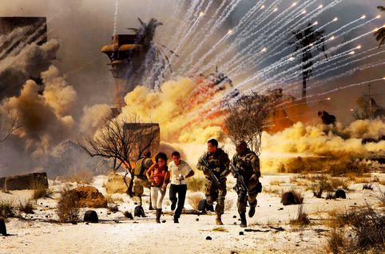
Costume
Lighting
props
Make-up
Acting/Action
Setting
Notes:
Effects
NARRATIVE, EMOTION, CHARACTER, TIME,

Slide 3
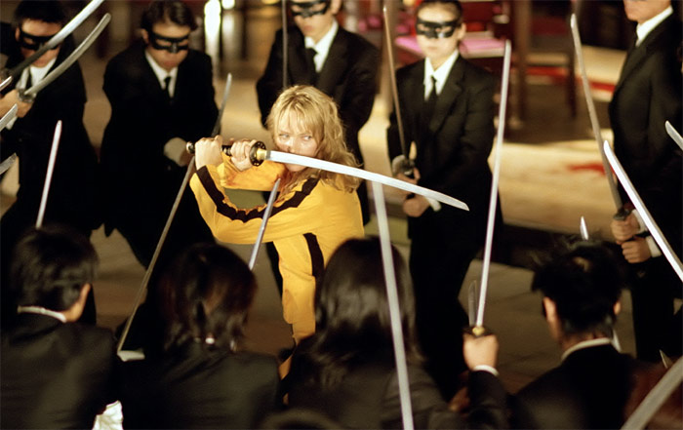
Costume
Lighting
props
Make-up
Acting/Action
Setting
Notes:
Effects
NARRATIVE, EMOTION, CHARACTER, TIME,

Slide 4
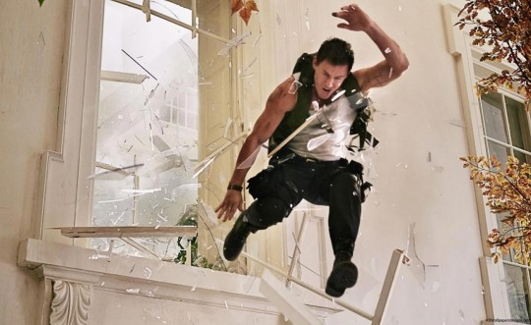
Costume
Lighting
props
Make-up
Acting/Action
Setting
Notes:
Effects
NARRATIVE, EMOTION, CHARACTER, TIME,

Slide 5
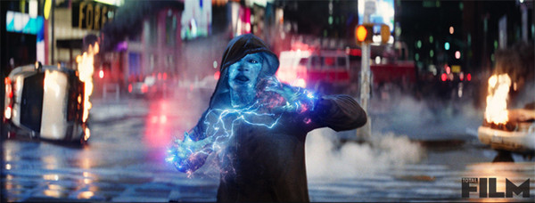
Costume
Lighting
props
Make-up
Acting/Action
Setting
Notes:
Effects
NARRATIVE, EMOTION, CHARACTER, TIME,

Slide 6
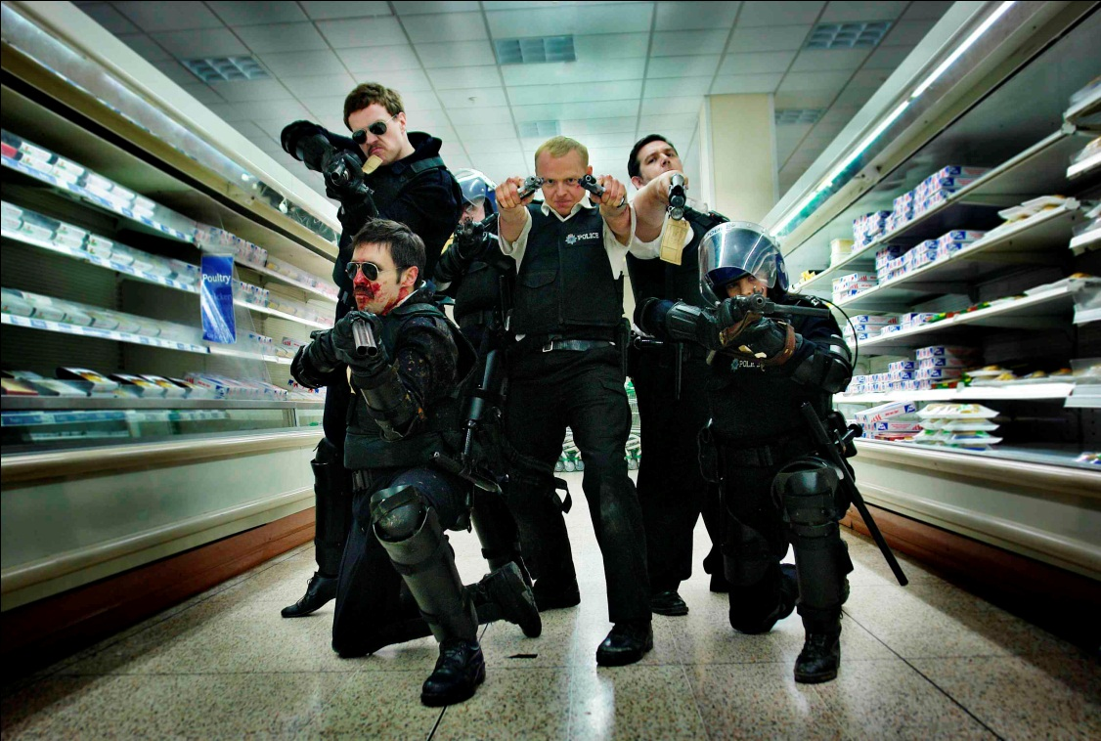
Costume
Lighting
props
Make-up
Acting/Action
Setting
Notes:
Effects
NARRATIVE, EMOTION, CHARACTER, TIME,

