Slide 1
Disney

Slide 2
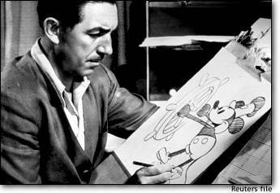
History
Formed in 1925 Walt Disney Productions by Walt Disney and his brother Roy. O Disney. It began life as Disney Brothers Cartoon Studio, and became a leader in the American animation industry.

Slide 3
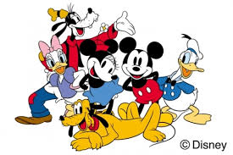
History
Early Disney characters include Mickey Mouse, Donald Duck, Goofy and Pluto

Slide 4
Present Day
The Walt Disney Company operates through four business segments
Studio Entertainment, with the primary business unit The Walt Disney Studios
film, music recording label, and theatrical productions
Parks and Resorts
theme parks, cruise line, and other travel-related assets;
Media Networks
television channels
Disney Consumer Products and Interactive Media
toys, clothing, and other merchandising based upon Disney-owned properties
Internet, mobile, social media, virtual worlds, and computer games operations

Slide 5
Entertainment Holdings
Walt Disney Studios
Disney Music Group
Disney Theatrical Group
Disney-ABC Television Group
Radio Disney
ESPN Inc.
Disney Interactive
Disney Consumer Products
Disney India Ltd.
The Muppets Studio
Pixar Animation Studios,
Marvel Entertainment
Marvel Studios
UTV Software Communications
Lucasfilm
Maker Studios.

Slide 6
Acquisitions & Mergers
Taking over or joining together with an existing companies for mutual benefit
Acquisitions:
ABC (American Broadcasting Company,
Lucasfilm (George Lucas, Star Wars)
The Muppets Studio (Jim Henson Company)
Marvel (Marvel Comics, Avengers, Spiderman)
Pixar (Toy Story)
Mergers
ESPN (Entertainment and Sports Programming Network – merger with Hearst Entertainment)

