Slide 1
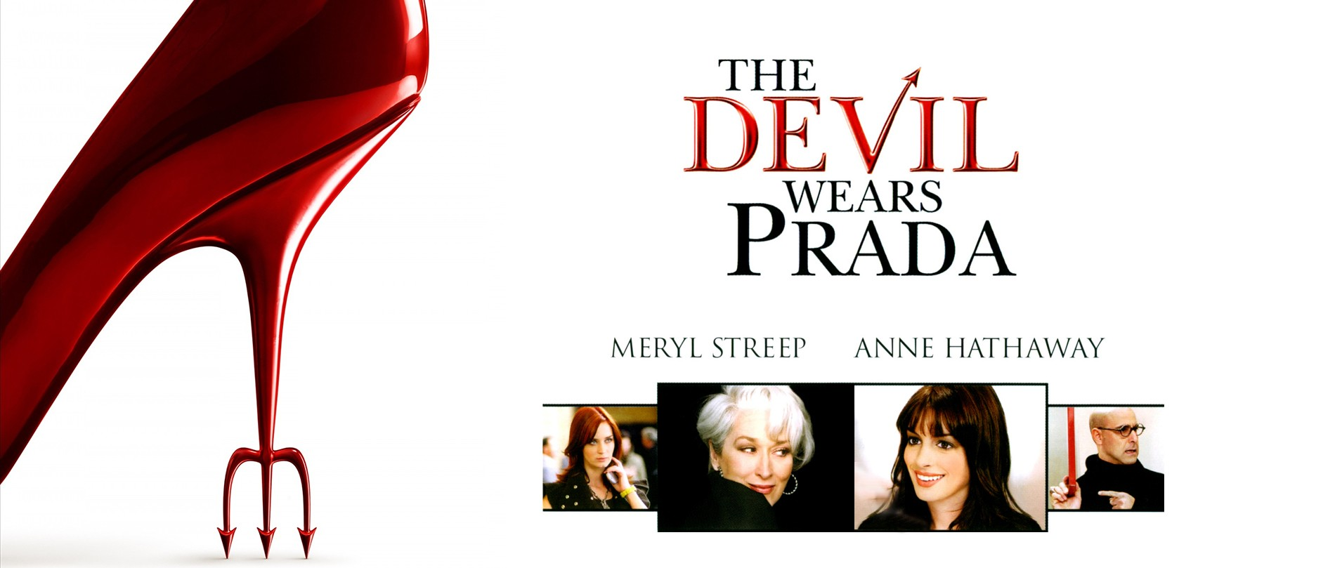
Using Camera To Create Effects
NARRATIVE
EMOTION
CHARACTER
SETTING/
TIME
The choices a director makes when deciding on which camera shot to use will be one or more of the above.
TASK: Look at the stills from The Devil Wears Prada. The boss of Runway Magazine, Miranda Priestley, is arriving at the office unexpectedly. Think about the choice of camera shot.
N – what do we learn about the story?
E – how do we feel when we watch the clip?
C – what do we learn about Miranda’s character? Emily? The office workers?
ST – how do we know where and when it is set?

Slide 2
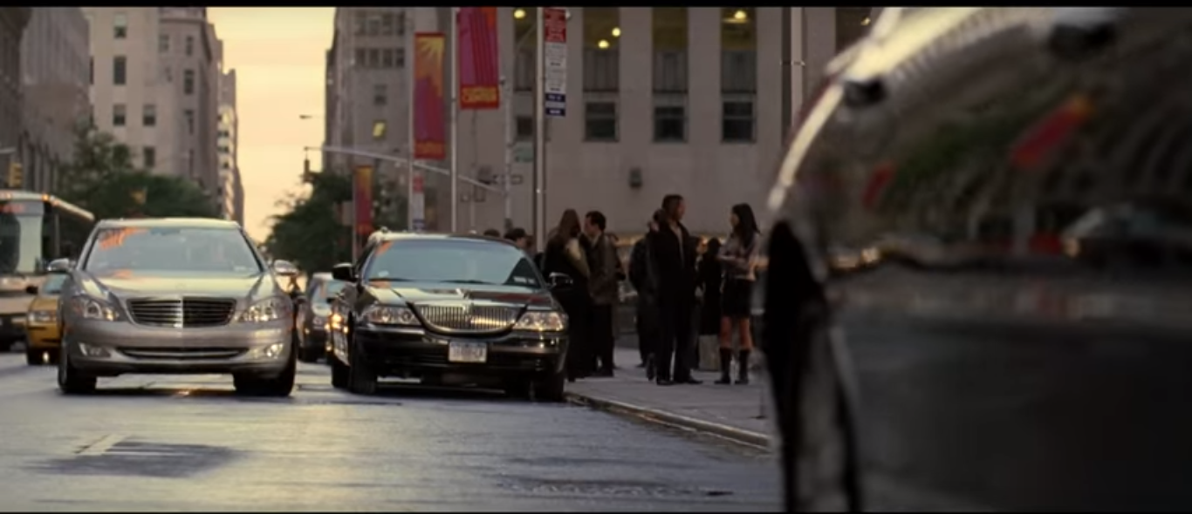
NOTES
Type of Shot
Why has this shot been chosen?

Slide 3
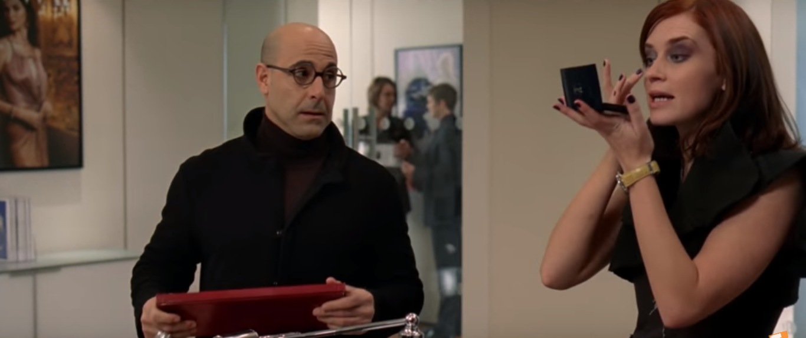
Type of Shot
Why has this shot been chosen?
Type of Shot
Why has this shot been chosen?

Slide 4
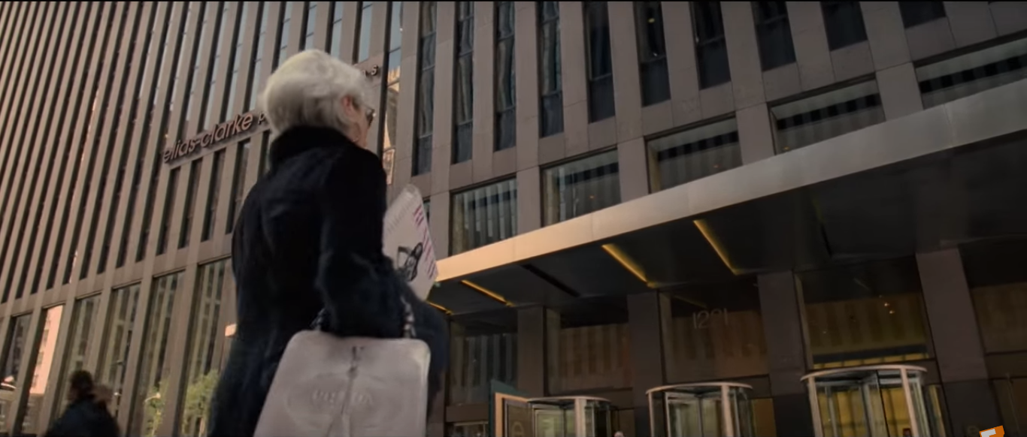
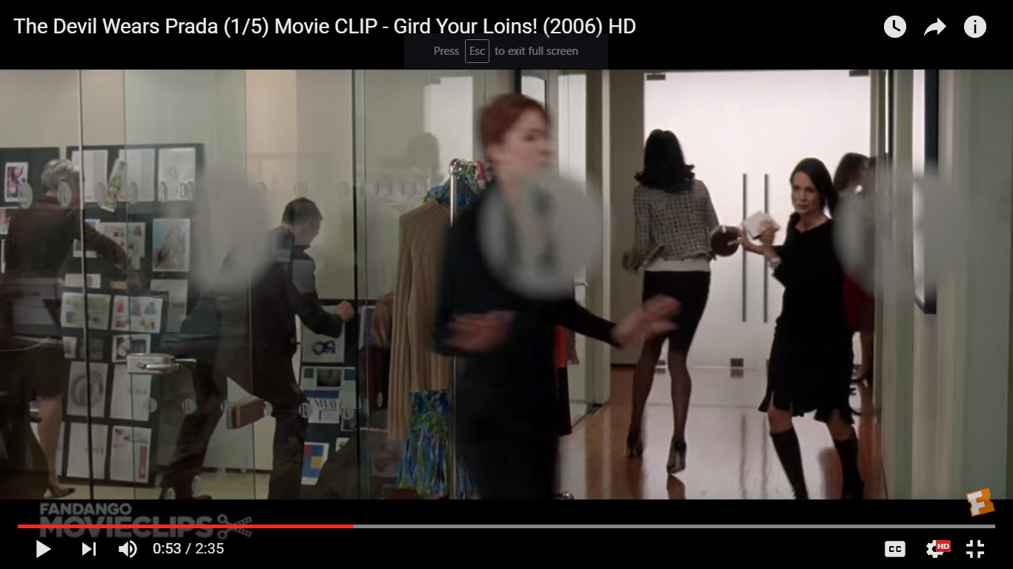
Type of Shot
Why has this shot been chosen?
Type of Shot
Why has this shot been chosen?

Slide 5
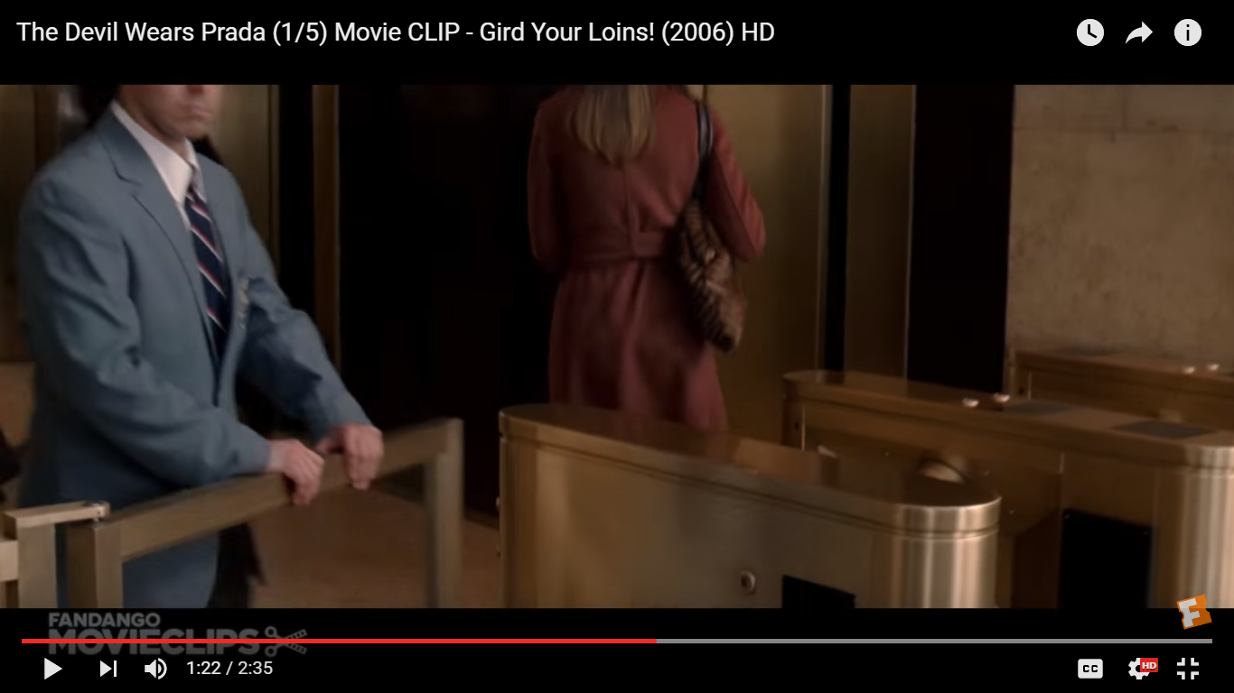
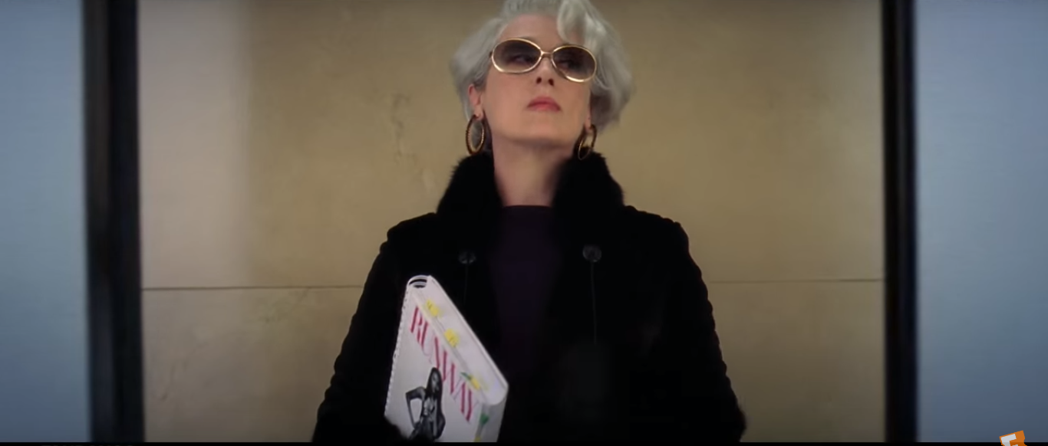
Type of Shot
Why has this shot been chosen?
Type of Shot
Why has this shot been chosen?

