Slide 1
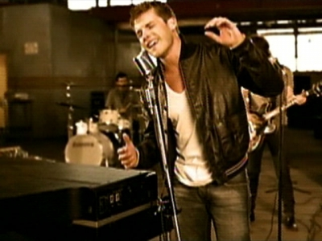
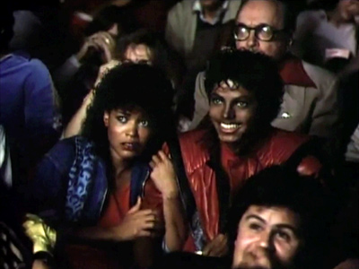
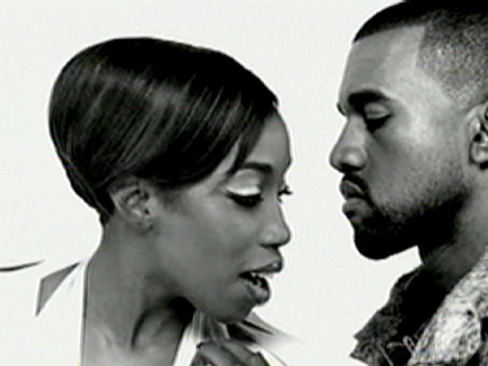
Andrew Goodwin’s Theory (Applied to music videos)

Slide 2
How to analyse music videos
Andrew Goodwin identifies 5 key aspects of music videos that we the audience should look out for which are:
. Thought beats – Seeing the sound
. Narrative and Performance
. The Star Image
. Relation of Visuals to Song
. Technical Aspects of Music Video

Slide 3
Thought Beats – Seeing the sound in your head
First step is to look at the music itself. We must take into account the structure of the song for e.g. Chorus/Verses .
Secondly, the voice of the song. The artists voice is extremely unique and can form identification or trademarks that work well with the star image. Roland Barthes theory of the Grain of voice can be related to this. He sees the singing voice as an expressive instrument and therefore able to make associations of its own.
Thirdly, Goodwin also points out the artists mode of address. Songs can be seen as stories and the artist the storyteller, making the music video a two communication device, them telling us a story and us listening.

Slide 4
Narrative & Performance
Songs fail to give us the complete narrative!
We only tend to get a gist of the meaning of the song and then tend to make up our own idea of what is being told.
Goodwin explains that music videos should ignore common narrative. It is important in their role of advertising.
Music videos should coherent repeatability. Narrative and performance work hand in hand it makes it easier for the audience to watch over and over without loosing interest.
The artist acting as both narrator & participant helps to increase the authenticity however the lip sync and other mimed actions remains the heart of music videos. The audience need to believe this is real.

Slide 5
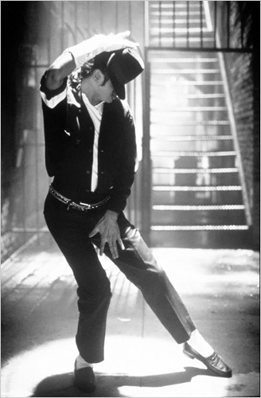
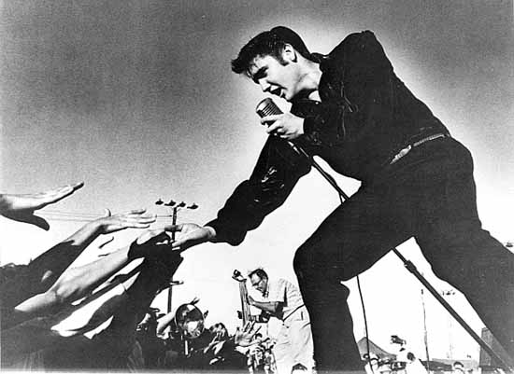
Star Image
The star image is another vital aspect of music videos. Meta narrative which is a big story that describes the development of the star over time, it has an important part to play in the music video production process.

Slide 6
Relation of Visuals to Song
Illustrate
Amplify
Disjuncture
Music videos can use a set of images to illustrate the meaning of lyrics & genre, this is the most common
This is similar to repeatability. Meanings and effects are manipulated and constantly shown through the video and drummed into our vision
This is where the meaning of the song is completely ignored
There are three ways in which music videos work to promote a song

Slide 7
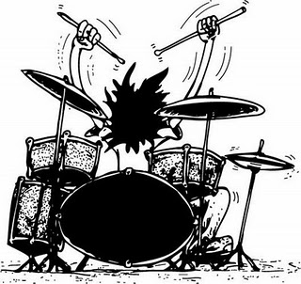
Technical Aspects
Technical aspects hold the music video together through use of camera work, movement, angle, mise- en -scene editing, sound and special effects.
Speed, camera movement, editing , cutting and post production are all forms of use of camera.
Lighting and colour help set moods and emphasise key moments of the song for dramatic effect
Mise-en-scene, the setting of music videos is vital, it needs to look authentic to attain professionalism .
Beats, music videos use cuts to go with the beat or rhythm making the video more entertaining.

