Slide 1
Andrew Goodwin
Codes and Conventions of Music Videos - Examples

Slide 2
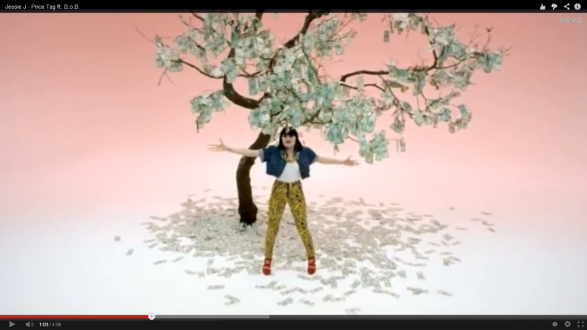
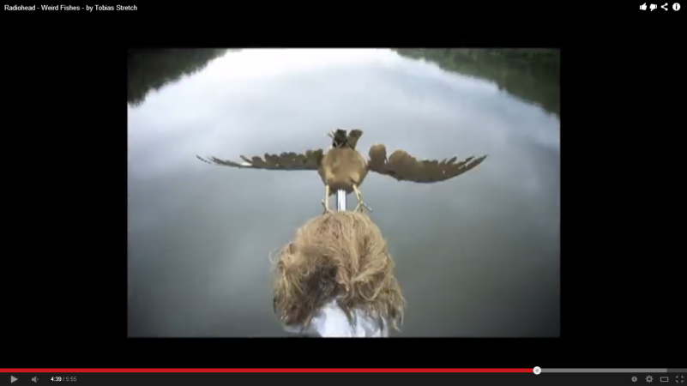
A relationship between the visuals either illustrating, amplifying or contradicting the lyrics.
A contradiction of the lyrics is shown through Jessie J’s “Price Tag”. At this point in the video the lyrics say “it’s not about the money, money, money” but Jessie is stood under a tree that is made of money. In this scene she is embracing the money and this a complete contradiction of the lyrics that are being said at that time.
On the other hand an amplification of the lyrics is shown through Radiohead’s “Weird Fishes”. At this point of the video the lyrics say “yeah I’ll, I’ll hit the bottom” and you can see the character falling towards the sea, about to hit the bottom. This scene then goes on to show a series of character falling into the sea, amplifying the lyrics at the time of video.

Slide 3
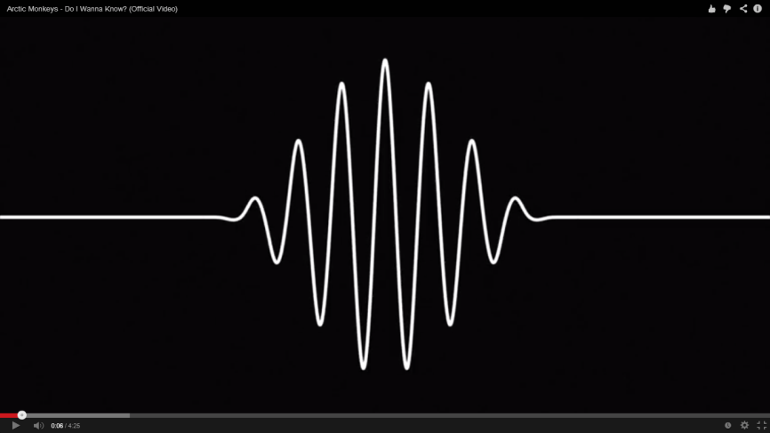
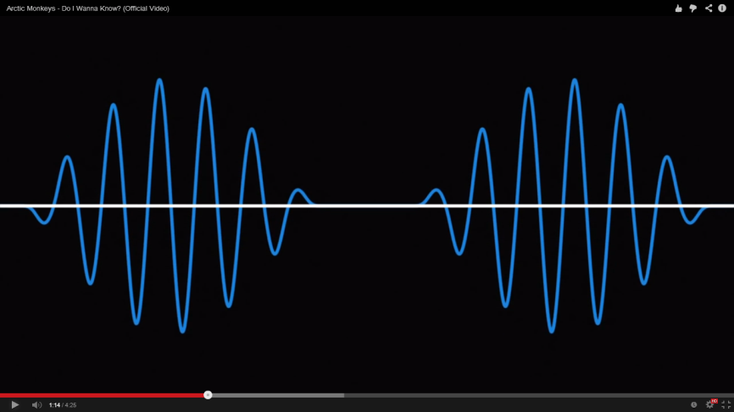
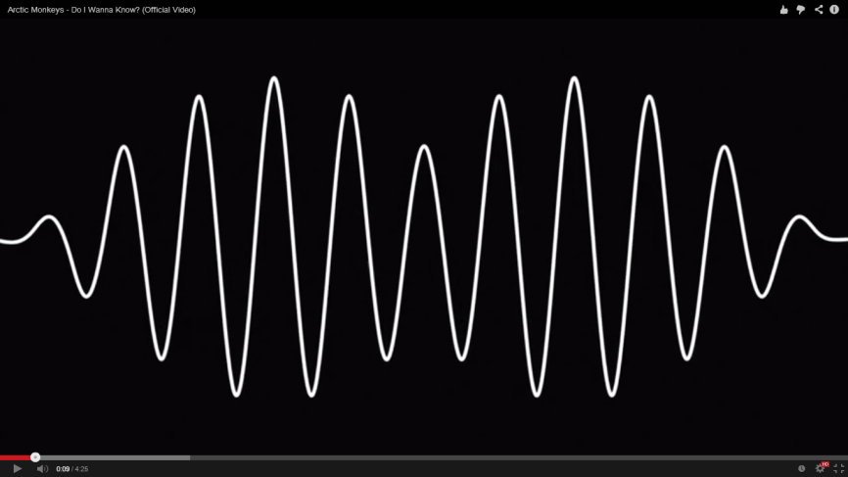
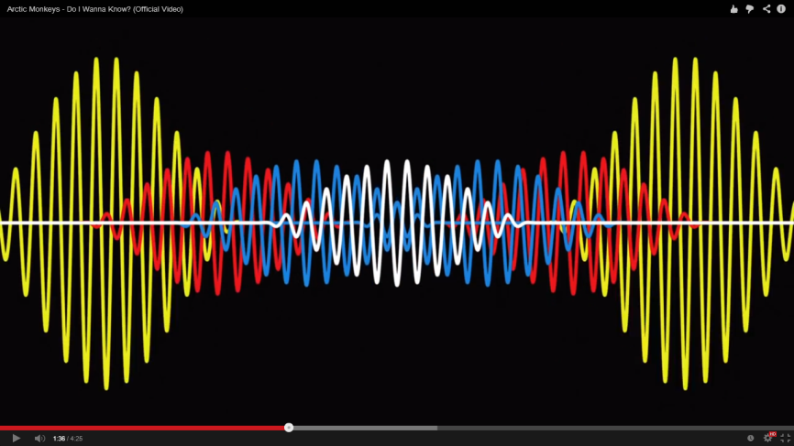
A relationship between the music and the visuals again either illustrating, amplifying and contradicting the music.
The music video ‘Do I Wanna Know’ by the Arctic Monkeys is a brilliant example of amplifying the beat of the song with the visuals. This music video is based around sound waves that move not only to the beat of the song but also to Alex Turner’s voice. This is a beautiful illustration of the beats within the song and more lines and colours are added as the song progresses due to extra instruments being added.

Slide 4
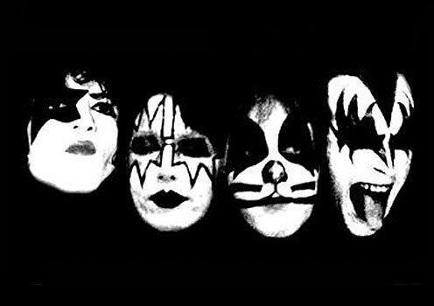
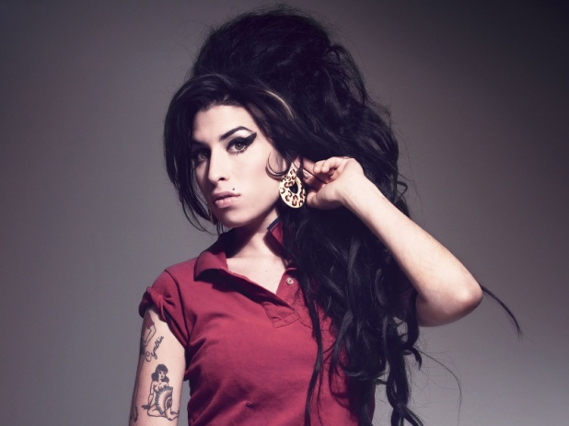
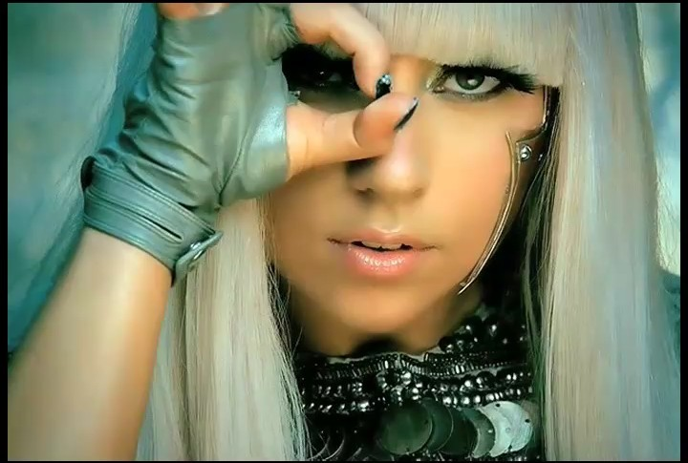
Music genres have their own music video style and iconography.
Kiss have established their own iconic star image through the use of their makeup. The band are instantly recognised everywhere due to this successful brand image and their trademark style.
Lady Gaga has also created a style of her own that means she is known worldwide for her wacky and wonderful fashion sense and hairstyles. Her music videos are instantly recognisable due to her trademark fashion sense.
Amy Winehouse has also created her star image with the classical ‘beehive’ hair-do and flicking eye makeup that she wore everywhere without fail: her music videos, live performances and every marketing photo shoot.

Slide 5
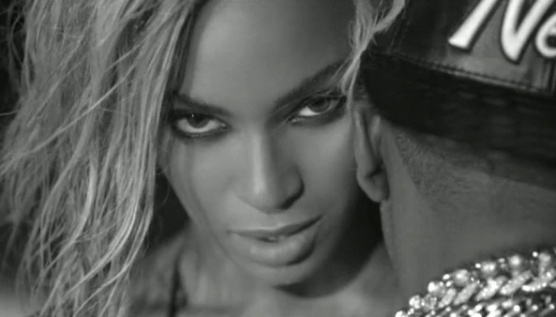
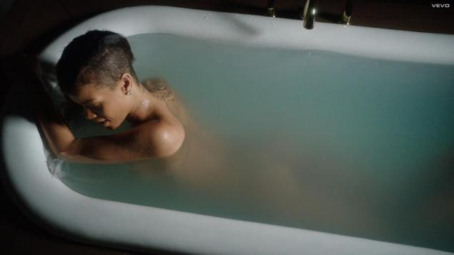
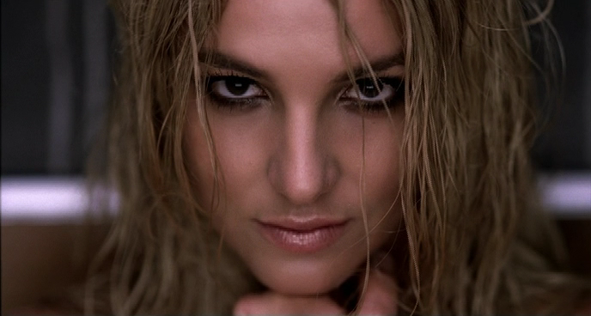
There is likely to be voyeurism, particularly in the treatment of women, and close-ups of the main artist or vocalist.
Rihanna, Katy Perry, Miley Cyrus, Beyonce and Britney Spears have all used provocative angles to show off their bodies in a voyeuristic way and they have also used sexualised close-ups to build up their brand image and to promote sales in their singles. All of the images below are examples of sexualised and provocative music videos.

Slide 6
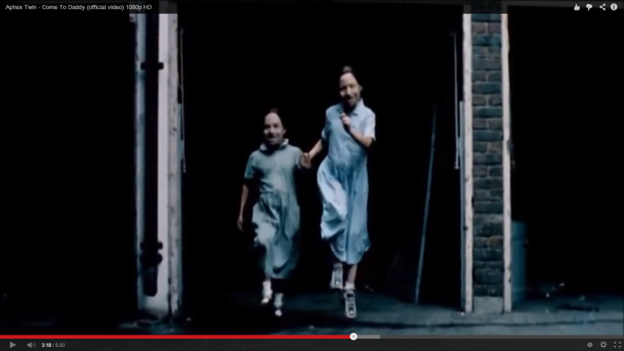
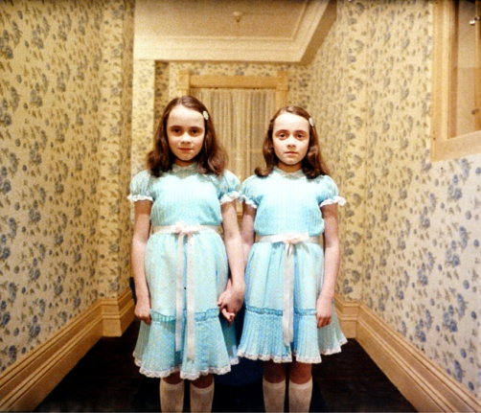
There is likely to be inter-textual references either to other music videos or to films or TV texts.
Aphex Twin – Come to Daddy. This music video has inter-textual references to a scene in The Shining. One of the scenes in the music video shows two of the “girls” skipping along and part of the over-layed music at that point is taken from The Shining – the part of the film where this is played links directly to the scene and you see two young girls skipping along a corridor.
Another inter-textual reference is with Blur – The Universal. This music video has references to the film The Clockwork Orange where it refers to a nihilistic society and uses the weird and deranged actions from this film within the music video. This is a link between the ideas that are conveyed within the music video rather then a visual reference as with the example above.

