Slide 1
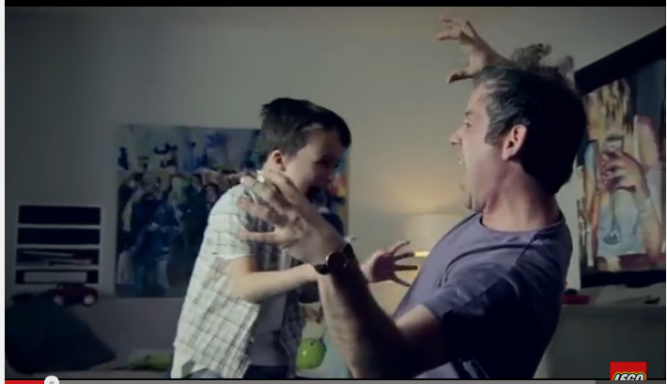
Camera Shot/denotation:
In what ways does this image suggest traditional male gender roles?

Slide 2
Camera Shot/denotation:
In what ways does this shot suggest stereotypical male gender roles?

Slide 3
Camera Shot/Denotation
The boy has made a crown for his dad. What does that suggest about male gender roles/the role of men in society?

Slide 4
Camera Shot/Denotation
What are they building? How is the father dressed? How does this reinforce traditional male gender roles?

Slide 5
Camera shot/Denotation
What kind of structure have they built? How are they feeling? What does this suggest about men?

