Slide 1
Unit 40 P1
Mise en scene

Slide 2
Denotation and Connotation
What can you see in the picture?
A rose
What does a rose suggest?
Romance
Denotation is what we can see in an image.
Connotation is the meaning we associate with that object.

Slide 3
What is the denotation and connotation of the following images?

Slide 7
Mise-en-Scène
Everything in the scene
C L A M P S
Costume
Lighting
Acting
Make up
Props
Setting

Slide 8
Mise-en-Scène
Everything that you seen in the image has been carefully chosen to give the audience a message. You have to think about what this message is.

Slide 9
How mise en scene helps the audience to understand the film
Atmosphere - the mood
Character – what the character is like
Time and Place – where and when the film takes place
Idea of
Narrative – the story
Genre – what type of film it is for example romance, horror

Slide 10
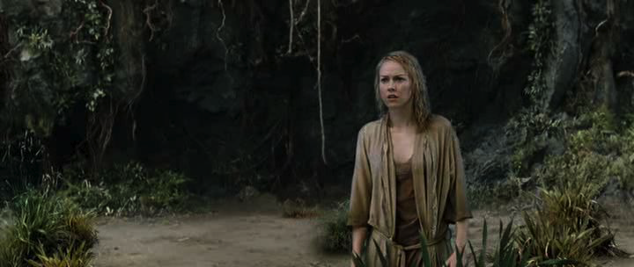
Make up and Hair, dirty, wet = suggest a struggle/being in a difficult situation
Let’s look at the mise en scene in this scene from King Kong
Acting – her facial expression looks worried, she’s alone which might suggest she is in danger
Setting
Jungle = wild/dangerous
Costume = wet nightclothes – old fashioned – the film is set in the past
vulnerable - also soiled suggesting signs of struggle
Notes:
We learn a lot about the story from looking at the mise en scene

Slide 11
Acting, Costume, Make-up and Hair
Acting, costume, hair and make–up signal to the audience:
What time period the film is set in
How important the character is
The character’s job/purpose
What social group they belong to
What kind of character they are – villain, hero etc.
Characters can alter their clothes and actions to suggest a change in any of these things.

Slide 12
Identify the mise-en-scène in a still from a film and think about the message that it might give to the audience. Remember to think about the denotation and connotation of symbols/images.

Slide 13
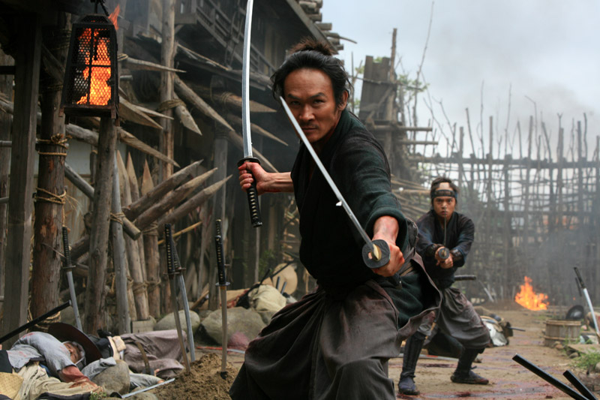

Slide 14
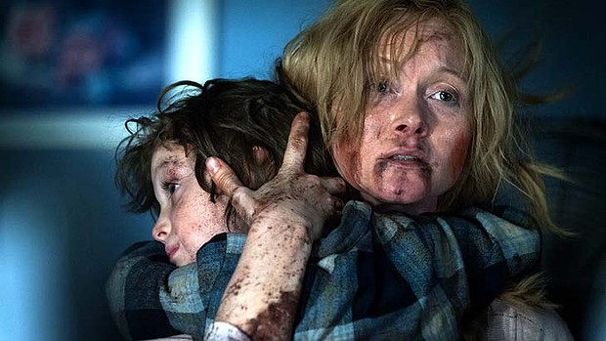

Slide 15
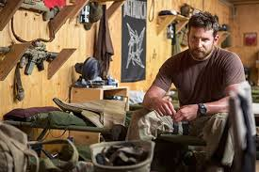

Slide 16
